Slide 1
ISP Semester 1 2023 - Judd Katz and Andrew Li
Supervisors Xanthe Croot and Alex Song
1
Can machine learning solve one of the biggest challenges in quantum computing?
Notes:
ML and quantum computing are two of the most exciting technological advances of our time, but can this leading software be applied to quantum hardware design to bring about the next generation of technological advancement for humanity?

Slide 2
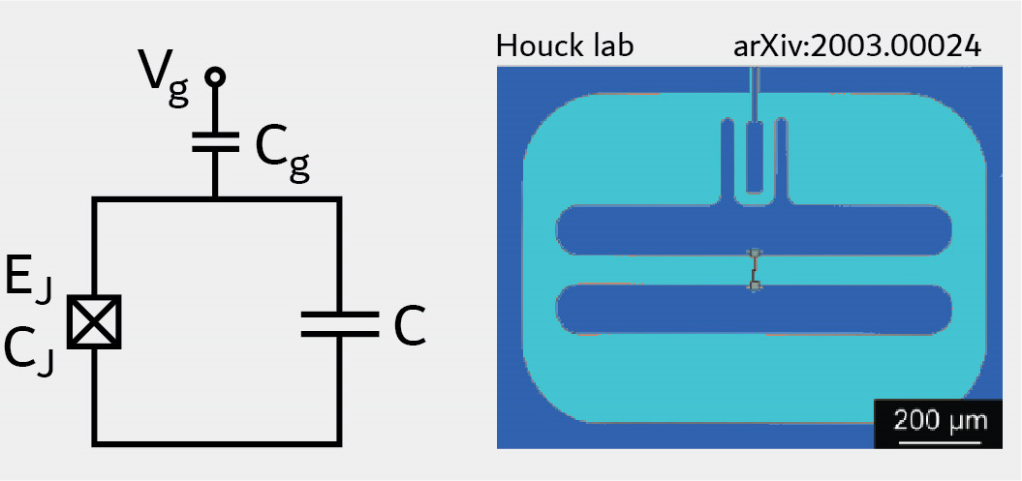
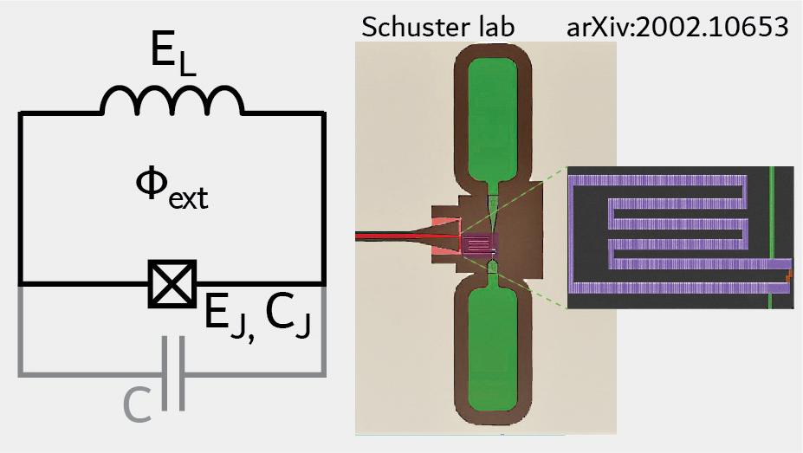
Superconducting Quantum Hardware
2
Transmon
A leading hardware choice for building qubits, used by Google and IBM
Superconducting electrical circuits
Josephson Junction
Single mode circuits - Transmon and Fluxonium Qubit
Fluxonium
Notes:
Superconducting circuits are electrical circuits powered by superconductors and have become a leading hardware choice for engineering qubits, the building blocks of a quantum computer.
The quantum properties of superconducting materials, paired with a special circuit element known as a Josephson junction enable these circuits to behave in manner suitable for performing quantum computations.
Until recently, the field has focused primarily on simple circuits with only 2 elements known as the transmon and fluxonium.
These circuits perform well, but noise has limited the realization of wide spread real life applications.

Slide 3

The Quantum Hardware Problem
3
Inescapable sources of quantum error/noise
Tradeoff trying to optimize depolarization ($T_{1}$) and dephasing ($T_{φ}$) noise
$$\frac{1}{T_{2}}=Γ_{2}=\frac{Γ_{1}}{2}+Γ_{φ}$$
Longer Coherence
Notes:
2 sources of error known as depolarization and dephasing contribute to this noise and for fundamental reasons there exists a tradeoff meaning that optimizing one causes the other to worsen as shown in the plot.

Slide 4
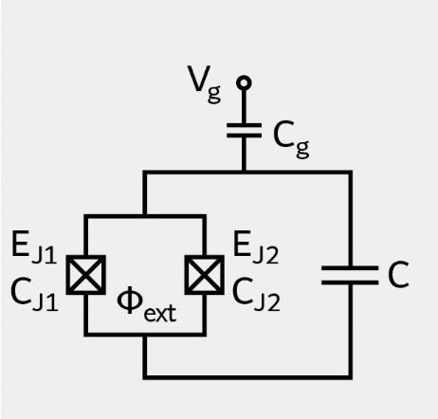
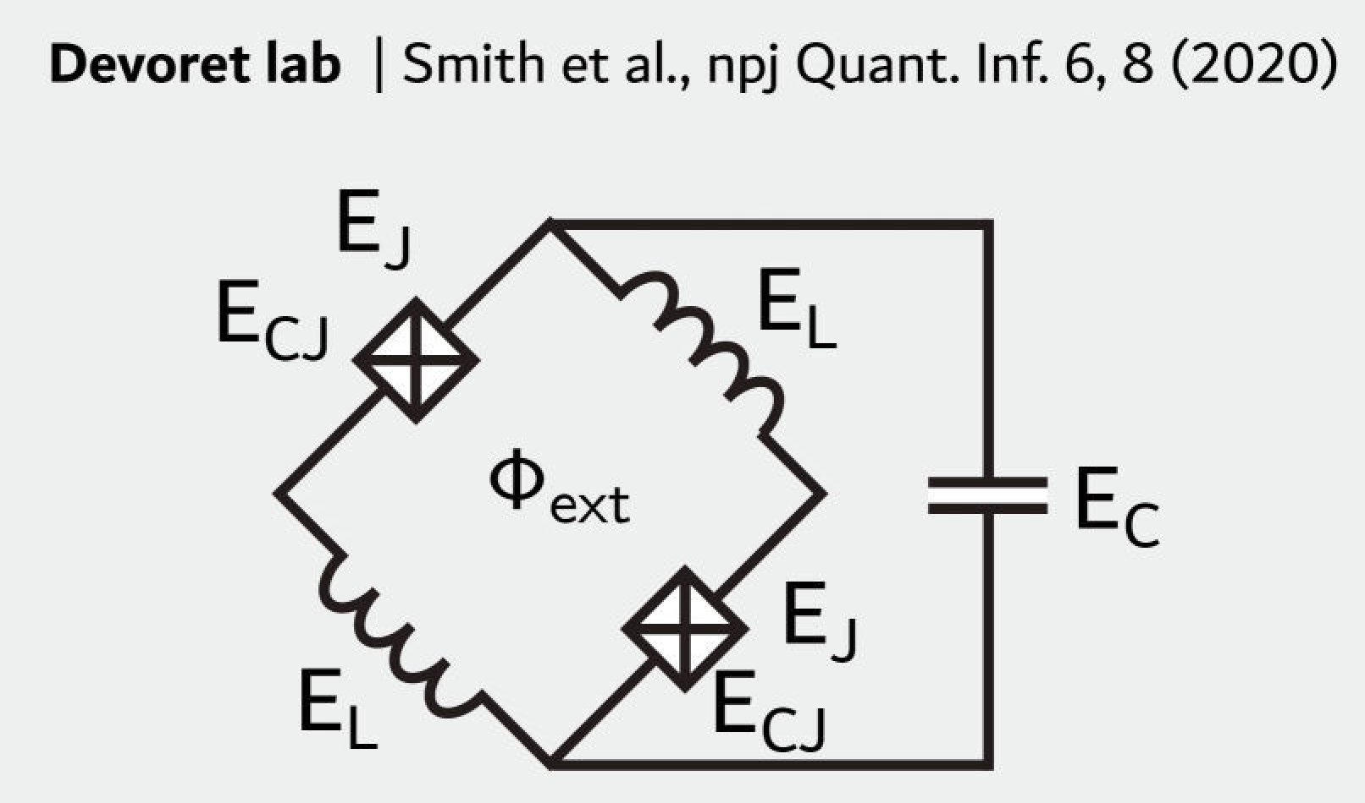
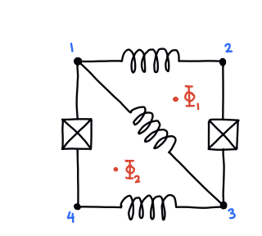
4
Can machine learning solve the quantum hardware problem?
“We investigate optimization algorithms from machine learning to optimize coherence times”
Protected Quits - investigating arbitrary superconducting circuits to reduce noise
Optimization techniques from machine learning could help
Notes:
To combat this noise the field of protected qubits has emerged to explore more complicated circuits that could possibly exhibit better coherence times.
However, finding the best performing qubits from the infinite number of possible choices, poses a significant challenge.
This optimization problem is exactly what the field of machine learning has learnt to solve.
As such, in our work we investigate optimization algorithms from machine learning to optimize coherence times in arbitrary superconducting circuits.

Slide 5
5
Goal
Increase qubit lifetimes
Decoherence rate depends on (many) circuit parameters
Objective
Pick circuit parameters to minimise rate function
Notes:
We want to make qubits last longer
So let’s fix a circuit design but keep its parameters adjustable
In other words, we want to lower the decoherence rate
We can consider the decoherence rate as a function of circuit parameters
Our goal then becomes to pick the best circuit parameters so to minimise the rate function

Slide 6
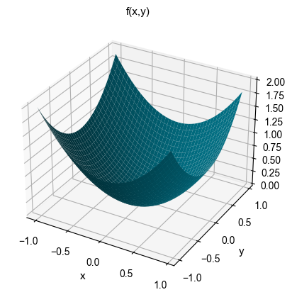
6
Gradient Descent
Reverse Mode Automatic differentiation / autograd
Break function down into sequence of simple functions
Appropriately calculate gradient of simple functions
v
v
From gradient calculate direction of steepest descent
Combine in reverse sequence to get gradient of original function
Our optimisation methods
Notes:
To solve this function optimisation problem we use gradient descent. Gradient descent minimises a function by following the path of steepest decrease. To find the direction of decrease, we need to find the rate at which the function changes with its parameters, and so we use automatic differentiation, a novel method in the field of superconducting qubits. Here, we break down our decoherence rate function into a sequence of elementary functions for which we calculate the exact gradients. We combine these in reverse order following a chain rule to get the gradient of the entire function.

Slide 7
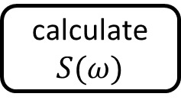


Our Work
7
Scqubits is a python library for simulating SC qubits. We:
examined its source code
integrated it with a machine learning library – pytorch – to implement GD and AD
calculate $S(ω)$
$S(ω)$
Circuit parameters
1
parameter
Overlap in states
0
T₂
solve energies
T₁
Energies
combine
$$\frac{δE_{01}}{δφ}$$
T_{φ}
A high level picture of how scqubits calculates decoherence times
E
Energy sensitivity
Notes:
To implement GD, we used as a template the source code of a python package called scqubits for simulating superconducting qubits. Here is a high level picture of how scqubits calculates decoherence rates. We modified its source code and integrated it with a machine learning library called pytorch that supported autograd.

Slide 8
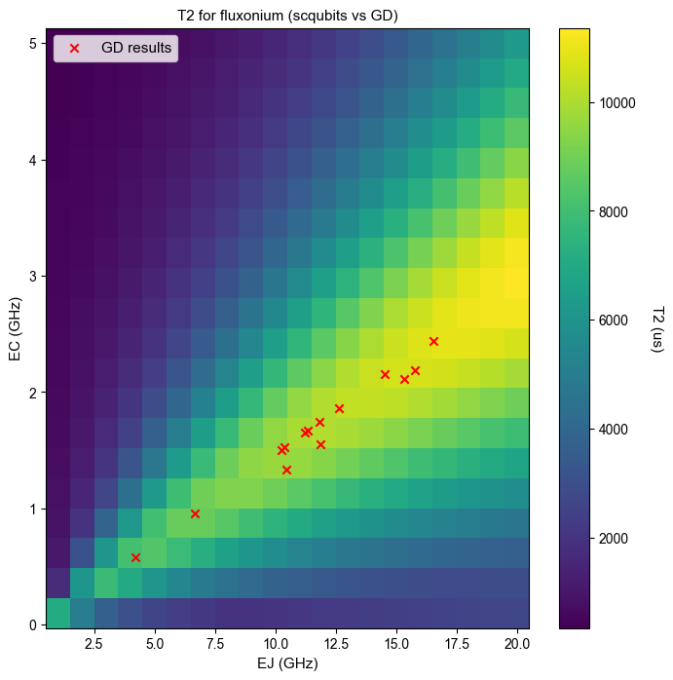
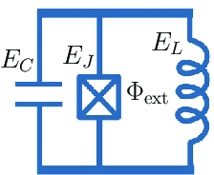
Testing on Fluxonium
8
Fluxonium is ideal as proof-of-concept
Comparing to scqubits, different runs of GD all move to the best T2 region
Notes:
The circuit which we used was fluxonium, which is ideal as a proof of concept as its parameter space is small enough that we can check our results against a plot of decoherence times over all parameter choices. As this graph shows, our results over multiple runs sit comfortably in a region of high decoherence time, thus validating our method.

Slide 9
Future of this Novel Work
Applying to zero-pi circuits
Apply to arbitrary circuits
Changing circuit design
“We have shown that automatic differentiation can be used to find optimum values of T2 in superconducting quantum circuits”
Notes:
Through our application on the fluxonium, this work has shown that automatic differentiation can be used to find optimum values of T2 in superconducting quantum circuits
To prove this novel approach further we should first apply the algorithm on other commonly studied circuits such as the zero-pi circuit and then build a generalized approach for arbitrary circuits.
Finally it would be useful to consider finding an algorithm that can optimize circuit topologies, not just parameter values, although this is a far more complex task.

Slide 10
Thank you Xanthe and Alex
10

Slide 11
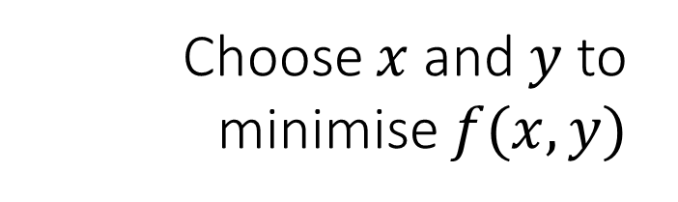
Gradient Descent
Objective
Pick circuit parameters to minimise rate function
Example
Choose $x$ and $y$ to minimise $f(x,y)$
Notes:
A standard method for solving this minimisation problem is called gradient descent
The idea, as illustrated here with an arbitrary function of some parameters x and y

Slide 12

Gradient Descent
1
Pick random values of $x$ and $y$
Notes:
- Is that we want to get some best choice of x and y from some random choice of x and y

Slide 13
Gradient Descent
1
Pick random values of $x$ and $y$
2
Find the direction of steepest descent
Notes:
From this nonoptimal choice, we then ask which direction should we move the parameters to decrease the function the most

Slide 14
Gradient Descent
3
Follow this direction for some distance
Notes:
And we then go in that direction for a bit

Slide 15
Gradient Descent
3
Follow this direction for some distance
2
Repeat 2 and 3
Notes:
And we keep doing this and so we eventually get to some low value of the function

Slide 16
Gradient Descent
Done!
Looks easy, but is harder with >2 parameters
Notes:
So for this graph, you can see just by eyeballing the graph where to go and where the lowest point is, but with more than 2 dimensions of parameters
This can be hard

Slide 17
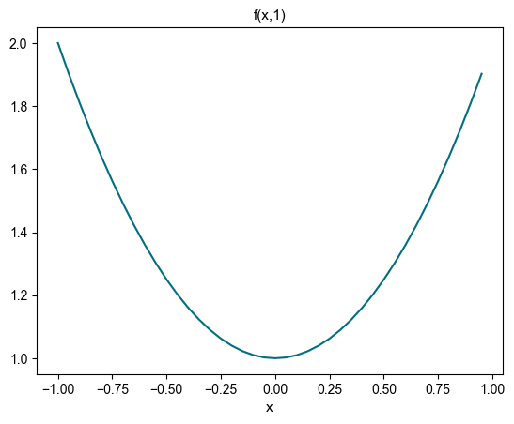
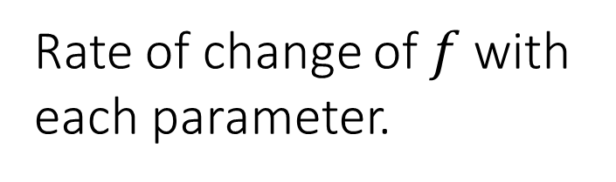
The gradient
Rate of change of $f$ with each parameter.
Used to find steepest direction
One way to find it: finite difference approximation
Notes:
The key thing that makes this hard is that we need to calculate the steepest direction down,
Which needs us to in turn calculate how f changes with each parameter
A crude way to do this is the finite difference approximation, where we take the slope between two points on the curve to approximate the slope of the curve in some direction

Slide 18
Finite difference has 2 problems…
1. Truncation error
2. Many function calls
1
2
We want to improve speed and accuracy
Notes:
This has two issues. First, its an approximation and suffers from what is called truncation error
Second, we need to calculate the slope in the direction of each parameter, and there could be many many parameters potentially
Which would mean wed need to calculate the function a lot
Speed and accuracy are important for more and more complicated problems

Slide 19
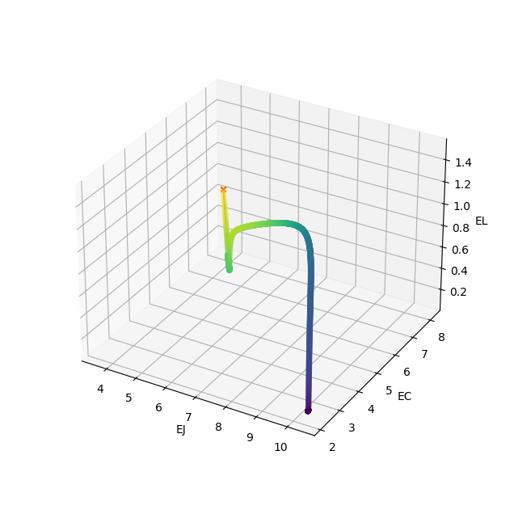
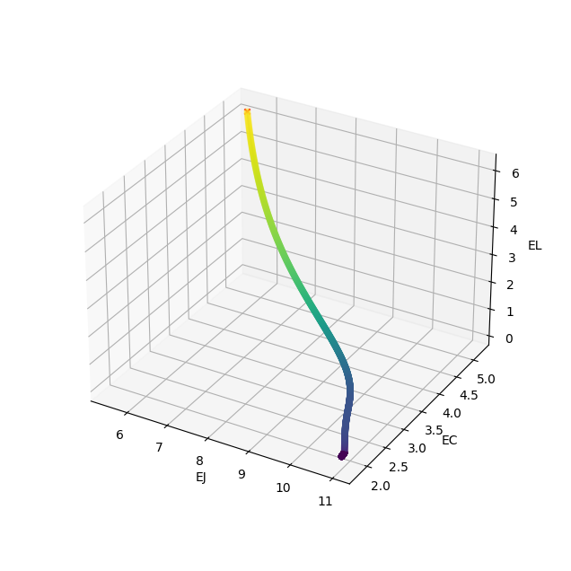
Results
Notes:
Here’s two results for fluxonium. The 3D coordinates represent the parameter choice, and the colour deeper the lower our decoherence rate is.
We can see that the gradient descent is working, and ends up in the same place for both runs. So this works as a proof of concept, and these results match theoretical predictions.

Slide 20
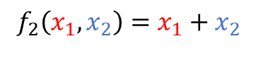
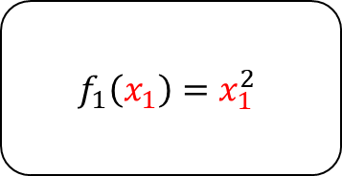

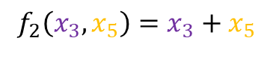




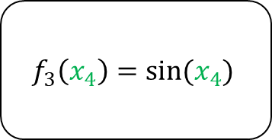

$f\left(x_{1},x_{2}\right)=x_{1}^{2}+sin⁡(x_{1}+x_{2})$
When calculating $x_{6}=f\left(x,y\right)$ we also store intermediate values
$$f_{1}\left(x_{1}\right)=x_{1}^{2}$$
$$x_{3}$$
$$x_{1}$$
$$f_{2}\left(x_{3},x_{5}\right)=x_{3}+x_{5}$$
$$x_{6}=f\left(x,y\right)$$
$$x_{5}$$
$$f_{3}\left(x_{4}\right)=sin⁡(x_{4})$$
$$x_{4}$$
$$x_{2}$$
$$f_{2}\left(x_{1},x_{2}\right)=x_{1}+x_{2}$$

Slide 21
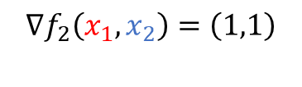
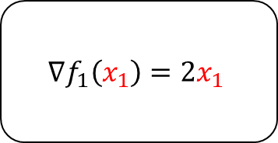
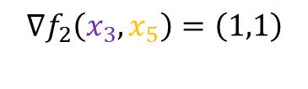
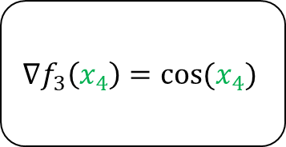
$f\left(x_{1},x_{2}\right)=x_{1}^{2}+sin⁡(x_{1}+x_{2})$
$$∇f\left(x_{1},x_{2}\right)= ?$$
$${∇f}_{1}\left(x_{1}\right)=2x_{1}$$
$$x_{3}$$
$$x_{1}$$
$${∇f}_{2}\left(x_{3},x_{5}\right)=\left(1,1\right)$$
$$x_{6}=f\left(x,y\right)$$
$$x_{5}$$
$${∇f}_{3}\left(x_{4}\right)=cos(x_{4})$$
$$x_{4}$$
$$x_{2}$$
$${∇f}_{2}\left(x_{1},x_{2}\right)=\left(1,1\right)$$

Slide 22

$f\left(x_{1},x_{2}\right)=x_{1}^{2}+sin⁡(x_{1}+x_{2})$
$$∇f\left(x_{1},x_{2}\right)= ?$$
$${∇f}_{1}\left(x_{1}\right)=2x_{1}$$
$$x_{3}$$
$$x_{1}$$
$${∇f}_{2}\left(x_{3},x_{5}\right)=\left(1,1\right)$$
$$x_{6}=f\left(x,y\right)$$
$$\frac{dx_{6}}{dx_{6}}=1$$
$$x_{5}$$
$${∇f}_{3}\left(x_{4}\right)=cos(x_{4})$$
$$x_{4}$$
$$x_{2}$$
$${∇f}_{2}\left(x_{1},x_{2}\right)=\left(1,1\right)$$

Slide 23


$f\left(x_{1},x_{2}\right)=x_{1}^{2}+sin⁡(x_{1}+x_{2})$
$$∇f\left(x_{1},x_{2}\right)= ?$$
$\frac{dx_{6}}{dx_{3}}={\left({∇f}_{2}\right)}_{1}∙$ $\frac{dx_{6}}{dx_{6}}=1$
$${∇f}_{1}\left(x_{1}\right)=2x_{1}$$
$$x_{3}$$
$$x_{1}$$
$${∇f}_{2}\left(x_{3},x_{5}\right)=\left(1,1\right)$$
$$x_{6}=f\left(x,y\right)$$
$$\frac{dx_{6}}{dx_{6}}=1$$
$$x_{5}$$
$\frac{dx_{6}}{dx_{5}}={\left({∇f}_{2}\right)}_{2}∙$ $\frac{dx_{6}}{dx_{6}}=1$
$${∇f}_{3}\left(x_{4}\right)=cos(x_{4})$$
$$x_{4}$$
$$x_{2}$$
$${∇f}_{2}\left(x_{1},x_{2}\right)=\left(1,1\right)$$

Slide 24

$f\left(x_{1},x_{2}\right)=x_{1}^{2}+sin⁡(x_{1}+x_{2})$
$$∇f\left(x_{1},x_{2}\right)= ?$$
$\frac{dx_{6}}{dx_{3}}={\left({∇f}_{2}\right)}_{1}∙$ $\frac{dx_{6}}{dx_{6}}=1$
$${∇f}_{1}\left(x_{1}\right)=2x_{1}$$
$$x_{3}$$
$$x_{1}$$
$${∇f}_{2}\left(x_{3},x_{5}\right)=\left(1,1\right)$$
$$x_{6}=f\left(x,y\right)$$
$$\frac{dx_{6}}{dx_{6}}=1$$
$$x_{5}$$
$\frac{dx_{6}}{dx_{5}}={\left({∇f}_{2}\right)}_{2}∙$ $\frac{dx_{6}}{dx_{6}}=1$
$${∇f}_{3}\left(x_{4}\right)=cos(x_{4})$$
$$x_{4}$$
$$x_{2}$$
$${∇f}_{2}\left(x_{1},x_{2}\right)=\left(1,1\right)$$
$\frac{dx_{6}}{dx_{4}}={\left({∇f}_{3}\right)}_{1}∙$ $\frac{dx_{6}}{dx_{5}}=cos⁡(x_{4})$

Slide 25

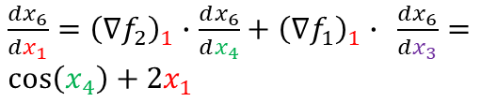
$f\left(x_{1},x_{2}\right)=x_{1}^{2}+sin⁡(x_{1}+x_{2})$
$$∇f\left(x_{1},x_{2}\right)= ?$$
$\frac{dx_{6}}{dx_{1}}={\left({∇f}_{2}\right)}_{1}∙$ $\frac{dx_{6}}{dx_{4}}+{\left({∇f}_{1}\right)}_{1}∙ \frac{dx_{6}}{dx_{3}}=\cos\left(x_{4}\right)+2x_{1}$
$\frac{dx_{6}}{dx_{3}}={\left({∇f}_{2}\right)}_{1}∙$ $\frac{dx_{6}}{dx_{6}}=1$
$${∇f}_{1}\left(x_{1}\right)=2x_{1}$$
$$x_{3}$$
$$x_{1}$$
$${∇f}_{2}\left(x_{3},x_{5}\right)=\left(1,1\right)$$
$$x_{6}=f\left(x,y\right)$$
$$\frac{dx_{6}}{dx_{6}}=1$$
$$x_{5}$$
$\frac{dx_{6}}{dx_{5}}={\left({∇f}_{2}\right)}_{2}∙$ $\frac{dx_{6}}{dx_{6}}=1$
$${∇f}_{3}\left(x_{4}\right)=cos(x_{4})$$
$$x_{4}$$
$$x_{2}$$
$${∇f}_{2}\left(x_{1},x_{2}\right)=\left(1,1\right)$$
$\frac{dx_{6}}{dx_{2}}={\left({∇f}_{2}\right)}_{2}∙$ $\frac{dx_{6}}{dx_{4}}=cos⁡(x_{4})$
$\frac{dx_{6}}{dx_{4}}={\left({∇f}_{3}\right)}_{1}∙$ $\frac{dx_{6}}{dx_{5}}=cos⁡(x_{4})$

Slide 26
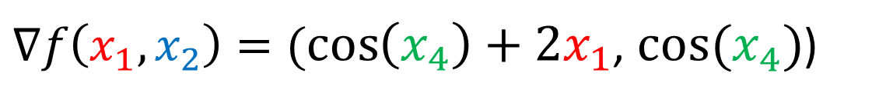
$f\left(x_{1},x_{2}\right)=x_{1}^{2}+sin⁡(x_{1}+x_{2})$
$∇f\left(x_{1},x_{2}\right)=(\cos\left(x_{4}\right)+2x_{1}$, $cos⁡(x_{4})$)
$\frac{dx_{6}}{dx_{1}}={\left({∇f}_{2}\right)}_{1}∙$ $\frac{dx_{6}}{dx_{4}}+{\left({∇f}_{1}\right)}_{1}∙ \frac{dx_{6}}{dx_{3}}=\cos\left(x_{4}\right)+2x_{1}$
$${∇f}_{1}\left(x_{1}\right)=2x_{1}$$
$$x_{3}$$
$$x_{1}$$
$${∇f}_{2}\left(x_{3},x_{5}\right)=\left(1,1\right)$$
$$x_{6}=f\left(x,y\right)$$
$$x_{5}$$
$${∇f}_{3}\left(x_{4}\right)=cos(x_{4})$$
$$x_{4}$$
$$x_{2}$$
$${∇f}_{2}\left(x_{1},x_{2}\right)=\left(1,1\right)$$
$\frac{dx_{6}}{dx_{2}}={\left({∇f}_{2}\right)}_{2}∙$ $\frac{dx_{6}}{dx_{4}}=cos⁡(x_{4})$

Slide 27
$f\left(x_{1},x_{2}\right)=x_{1}^{2}+sin⁡(x_{1}+x_{2})$
$$∇f\left(x_{1},x_{2}\right)=(\cos\left(x_{4}\right)+2x_{1}\text{, }cos⁡(x_{4})\text{)}$$
$\frac{dx_{6}}{dx_{1}}={\left({∇f}_{2}\right)}_{1}∙$ $\frac{dx_{6}}{dx_{4}}+{\left({∇f}_{1}\right)}_{1}∙ \frac{dx_{6}}{dx_{3}}=\cos\left(x_{4}\right)+2x_{1}$
$\frac{dx_{6}}{dx_{3}}={\left({∇f}_{2}\right)}_{1}∙$ $\frac{dx_{6}}{dx_{6}}=1$
$${∇f}_{1}\left(x_{1}\right)=2x_{1}$$
$$x_{3}$$
$$x_{1}$$
$${∇f}_{2}\left(x_{3},x_{5}\right)=\left(1,1\right)$$
$$x_{6}=f\left(x,y\right)$$
$$\frac{dx_{6}}{dx_{6}}=1$$
$$x_{5}$$
$\frac{dx_{6}}{dx_{5}}={\left({∇f}_{2}\right)}_{2}∙$ $\frac{dx_{6}}{dx_{6}}=1$
$${∇f}_{3}\left(x_{4}\right)=cos(x_{4})$$
$$x_{4}$$
$$x_{2}$$
$${∇f}_{2}\left(x_{1},x_{2}\right)=\left(1,1\right)$$
$\frac{dx_{6}}{dx_{2}}={\left({∇f}_{2}\right)}_{2}∙$ $\frac{dx_{6}}{dx_{4}}=cos⁡(x_{4})$
$\frac{dx_{6}}{dx_{4}}={\left({∇f}_{3}\right)}_{1}∙$ $\frac{dx_{6}}{dx_{5}}=cos⁡(x_{4})$

